Slide 1
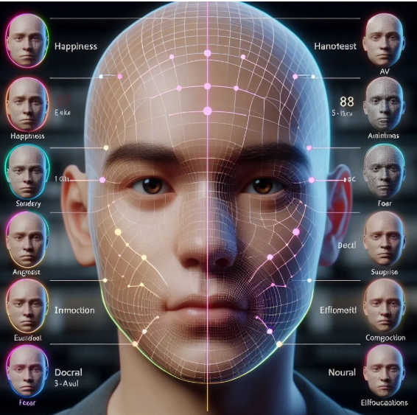

CAPSTONE PROJECT REAL TIME facIAL emotion detection USING DEEP LEARNING
Presented By
Student Name: SHUBHAM
College Name: KR.MANGALAM UNIVERSITY
Department: BTECH CSE AI/ML
Email ID: shubhamramdhiraj@gmail.com
AICTE Student ID: STU67d713f569a1e1742148597

Slide 2
OUTLINE
Problem Statement
Proposed System/Solution
System Development Approach
Algorithm & Deployment
Result (Output Image)
Conclusion
Future Scope
References

Slide 3
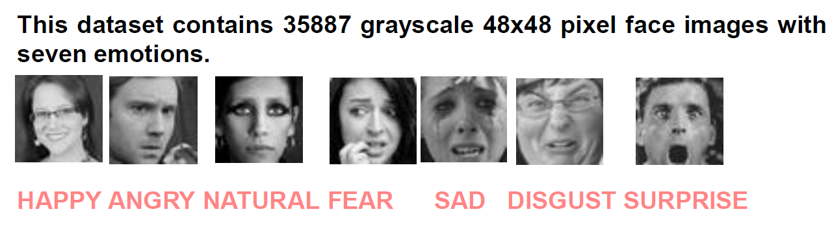
Problem Statement
Humans express emotions using facial expressions. Recognizing these emotions manually is subjective and inefficient.
There is a growing need for intelligent systems that can automatically detect emotions in real-time, especially in applications like healthcare, online education, human-computer interaction, and mental wellness.
The challenge lies in accurately detecting and classifying emotions using facial features in real-time video feeds.
DataSet link :- https://www.kaggle.com/c/challenges-in-representation-learning-facial-expression-
recognition-challenge

Slide 4
Proposed Solution
The proposed system captures real-time facial expressions using a webcam and classifies emotions using a deep learning model.
Key Features:
- Real-time emotion detection using OpenCV and Keras
- CNN model trained on facial emotion dataset (48x48 grayscale images)
- Integration of computer vision for face detection
- Seven emotion classes: Angry, Disgust, Fear, Happy, Neutral, Sad, Surprise

Slide 5
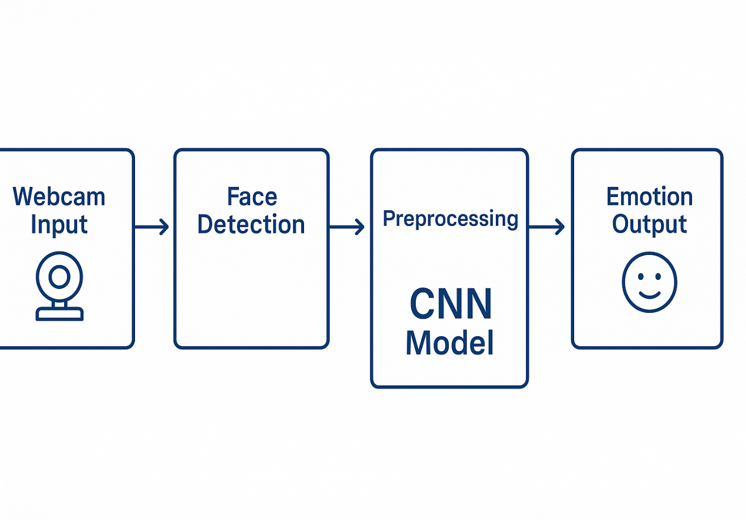
System Approach
Technologies Used:
- Python
- OpenCV for face detection
- Keras (TensorFlow backend) for emotion classification
- NumPy for preprocessing
- Haar Cascade for detecting face regions
Libraries Required:
- keras
- opencv-python
- numpy

Slide 6
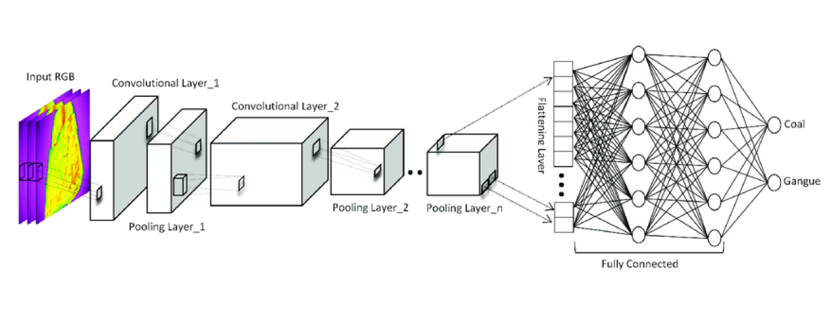
Algorithm & Deployment
Algorithm Used: Convolutional Neural Network (CNN)
Training Process:
- Dataset: FER2013 (facial emotion recognition)
- Model Input: 48x48 grayscale images
- Output: 7 emotion classes via softmax activation
Deployment:
- Model saved as .json and .h5 files
- Real-time video captured via OpenCV
- Model prediction displayed live on screen

Slide 7
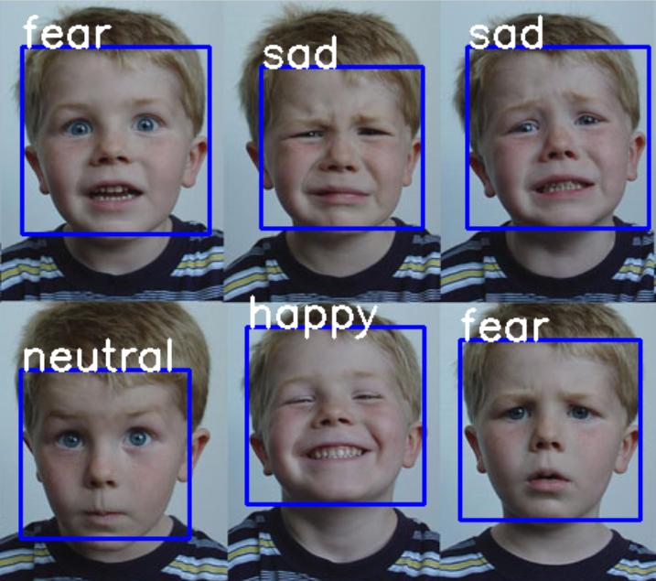
Result
The model successfully classifies emotions from real-time webcam input with high accuracy.
Example Output:
Detected Face: Label = "Happy“
Detected Face: Label = “Sad“
Detected Face: Label = “Fear“
Detected Face: Label = “Surprise“
Detected Face: Label = “Neutral“
Detected Face: Label = “Angry“

Slide 8

Conclusion
This system demonstrates a practical application of AI and deep learning for emotion recognition.
The project provided hands-on experience with:
- AI model training
- Computer vision integration
- Real-time deployment and testing
It shows how AI can enhance user interaction and mental health tracking through emotion-aware systems.

Slide 9
Future scope
- Train on larger and diverse datasets to improve accuracy
- Deploy as a web or mobile app using Flask or Android
- Integrate real-time dashboards or analytics
- Combine voice + facial emotion detection
- Explore edge AI for on-device emotion detection

Slide 10
References
- [1] FER2013 Dataset
- [2] Keras Documentation
- [3] OpenCV Face Detection
- [4] Microsoft Azure AI Services
GitHub Repository: [https://github.com/shubham055555/Facial-Emotion-Detection-using-Deep-Learning-and-OpenCV ]
My Github Profile : (https://github.com/shubham055555)

Slide 11
Thank you

